Slide 1
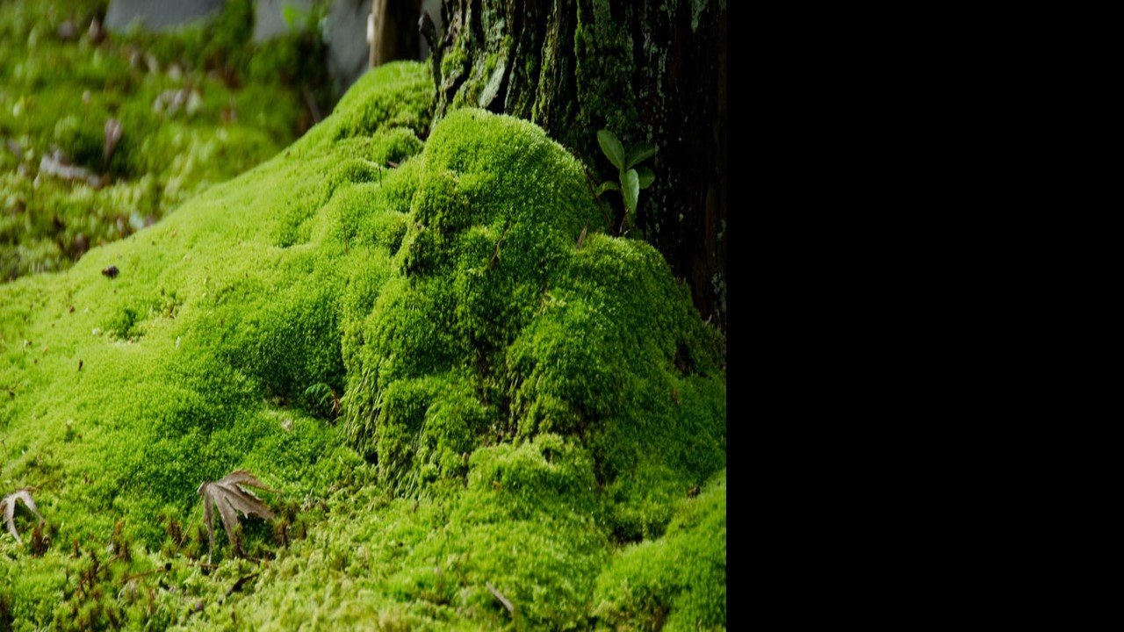

How can moss help in fighting air pollution?
Scientists from the University of Freiburg in Germany did a research

Slide 2
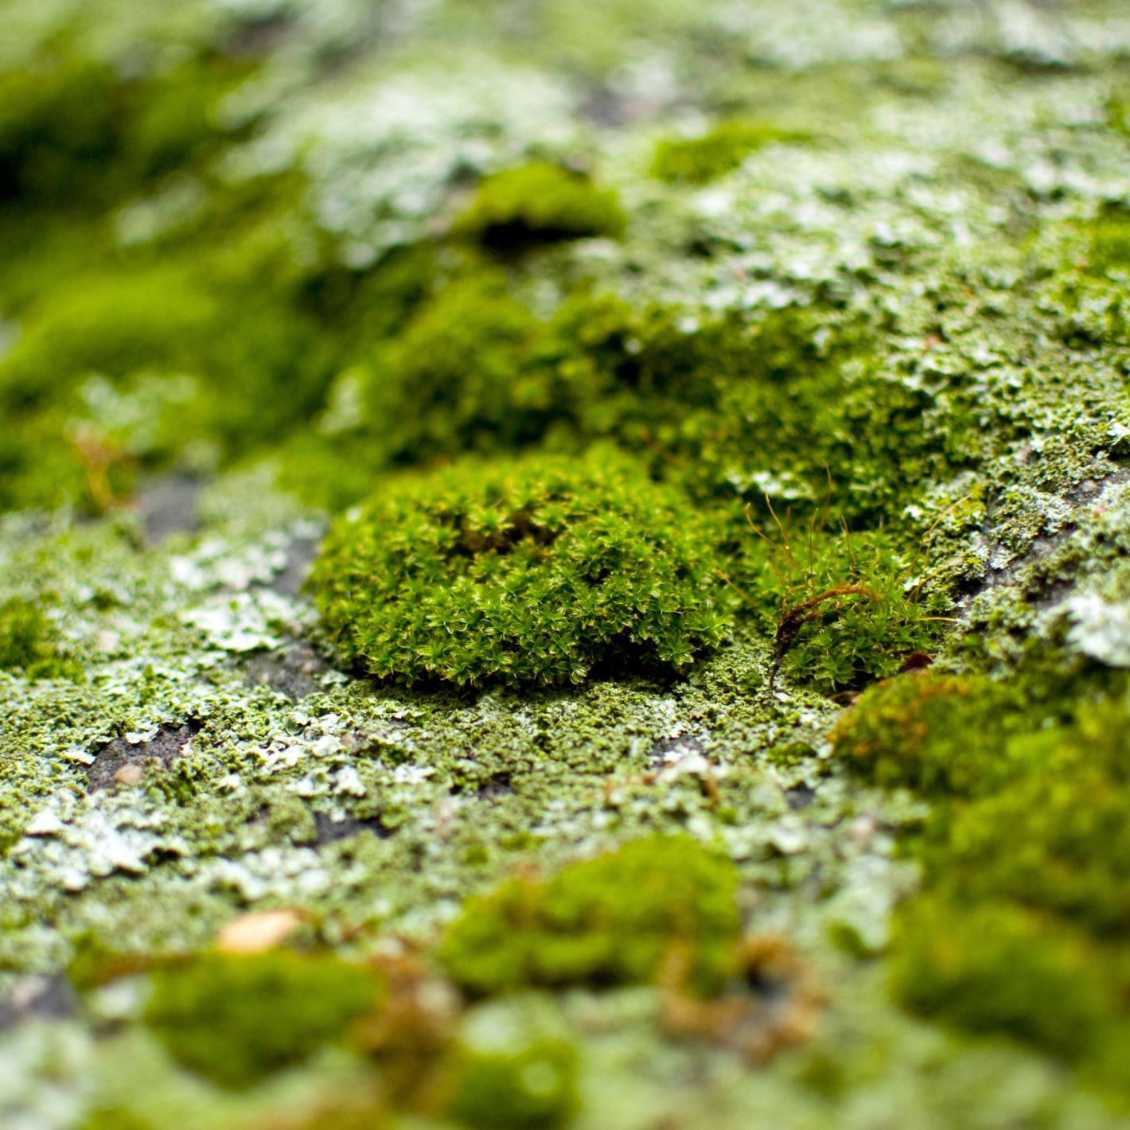


Why did they use mosses?
No roots
Mosses have a high surface area
They have the ability to clean dirt particles of the air
Their spores are used to grow new plants
Bio monitoring
This is the technique used to describe the approach the study
of biological responses to the air pollution
Observing sulphur and nitrogen oxides, lead, cadmium and
nickel is difficult and expensive.
Moses can be easily be developed for bio monitoring

Slide 3
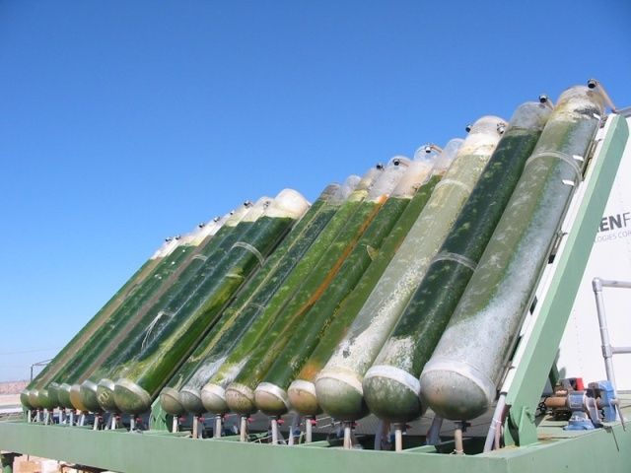
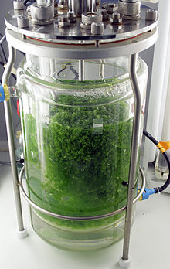
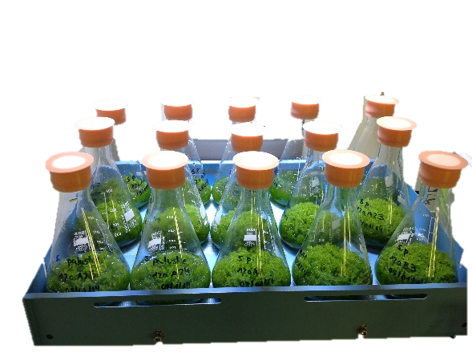
How did the scientists experimented this?
They wanted to make clones of certain mosses that could absorb these
dirt particles in equal amounts
A large amount of peat mosses were also produced
A moss bioreactor was used for this purpose under controlled conditions

Slide 4


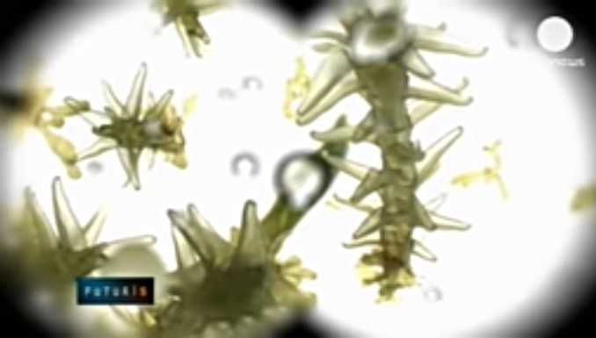
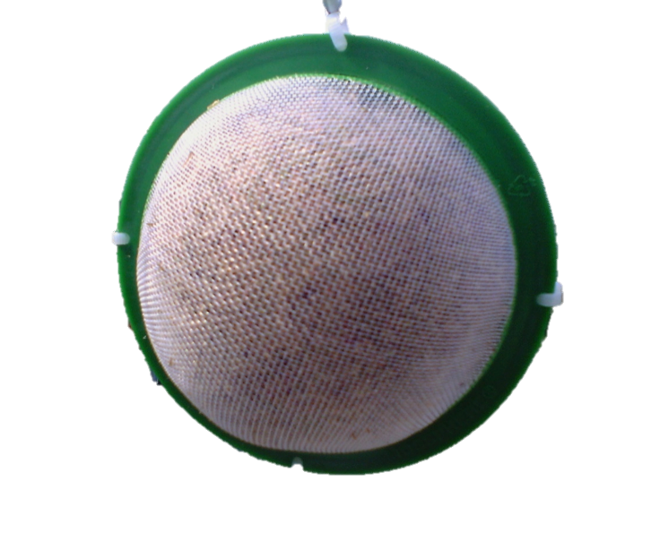
This clones were observed under a microscope
They reduced the genetic variability therefore the growth and the level of pollution
absorption can be identical for
every clone.
These biotechnologically developed mosses were then
place in air permeable bags

Slide 5

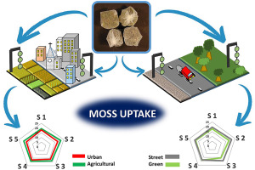

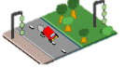


They were moved to monitoring station in Europe in
which they absorbed the air pollutants
3 different samples were kept for 3 weeks in order to
collect the pollutants due to road traffic
Next these mosses were dried and then powdered
to be analyzed
Researches are been conducted to develop
these mosses to clean the air pollution completely
In Santiago these are been placed in busy
roads
Their final goal is to clean all the toxic
chemicals in the air
S1
S5 S2
S4 S3
S1
S5 S2
S4 S3
Urban
Agricultural
Street
Greens

Slide 6

